Slide 1
Comparing Two EU Candidates: Ukraine and Turkiye
MEF BDA503- Astral Projection
Team Members:
Gözde Uğur
Melihcan Akgül
Derya Şaşmaz
Burcu Altıparmak

Slide 2

Introduction
In this analysis, we focused on the years 2018 to 2022, we conducted a comparative analysis between two countries according to spesific key indicators, Ukraine and Turkiye, both aspiring to become candidates for the European Union.
Key Indicators:
Total Population
GDP per capita
Age Dependency Ratio
Inflation
Unemployment Rate
Gender-specific Labor Force Participation Rates

Slide 3
Key Takeaways
Comparative assessment of Turkiye and Ukraine's credentials for EU membership.
Post-COVID-19 impact: Turkiye faces significant inflation, four times higher in 2022.
Turkiye's advantageous position due to a larger GDP per capita, population, and lower age dependency ratio.
Ukraine's population decline and increased age dependency ratio due to war.
Both nations need to address challenges in political stability and economic harmonization for EU accession.

Slide 4

Outcomes

Slide 5
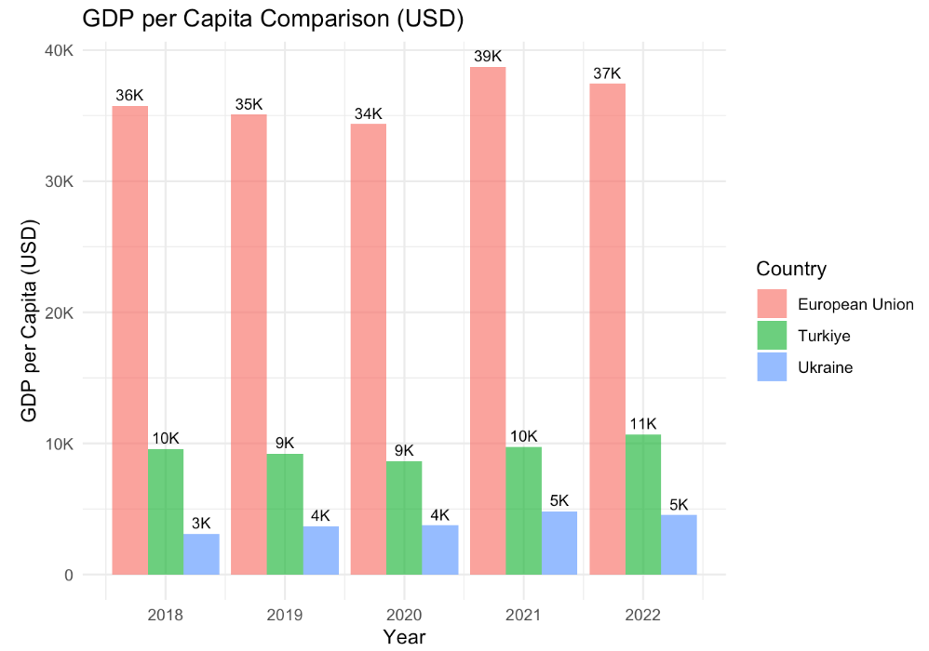
GDP per Capita Comparison (USD)

Slide 6
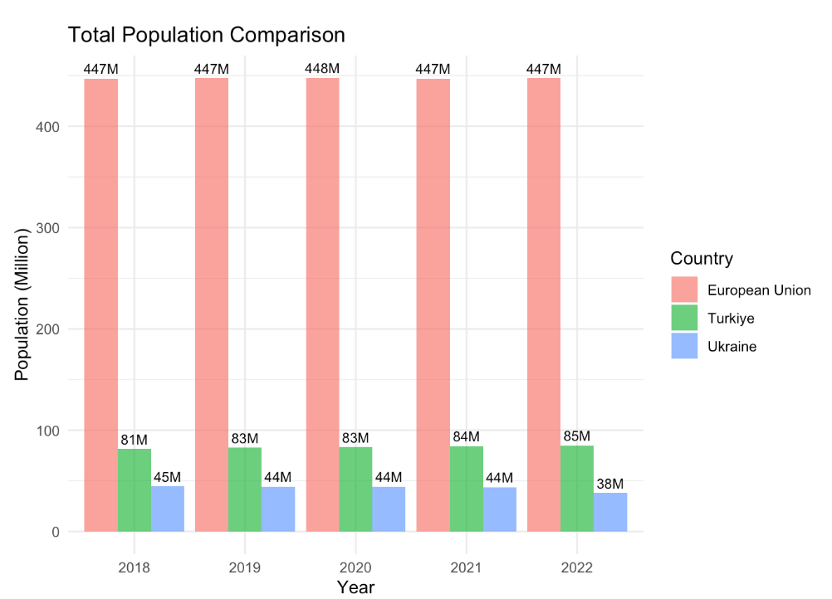
Total Population Comparison

Slide 7
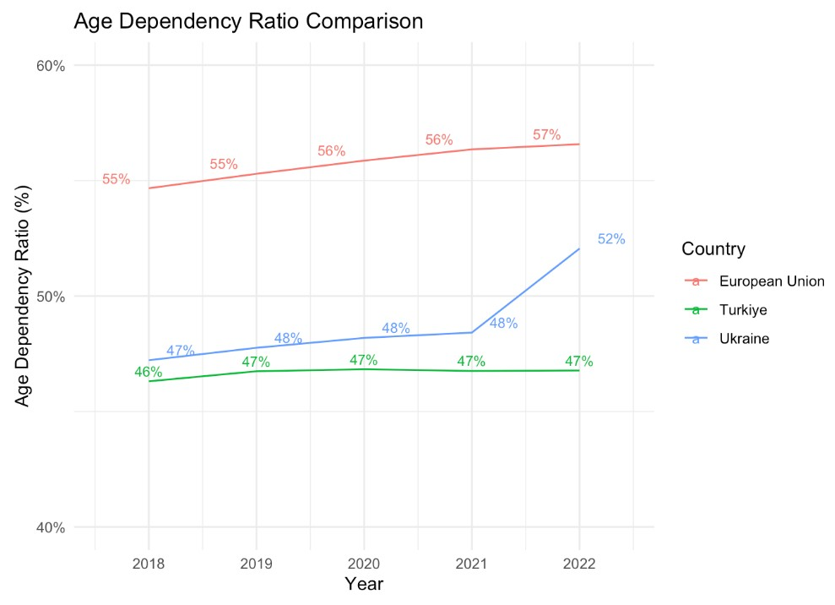
Age Dependency Ratio Comparison

Slide 8
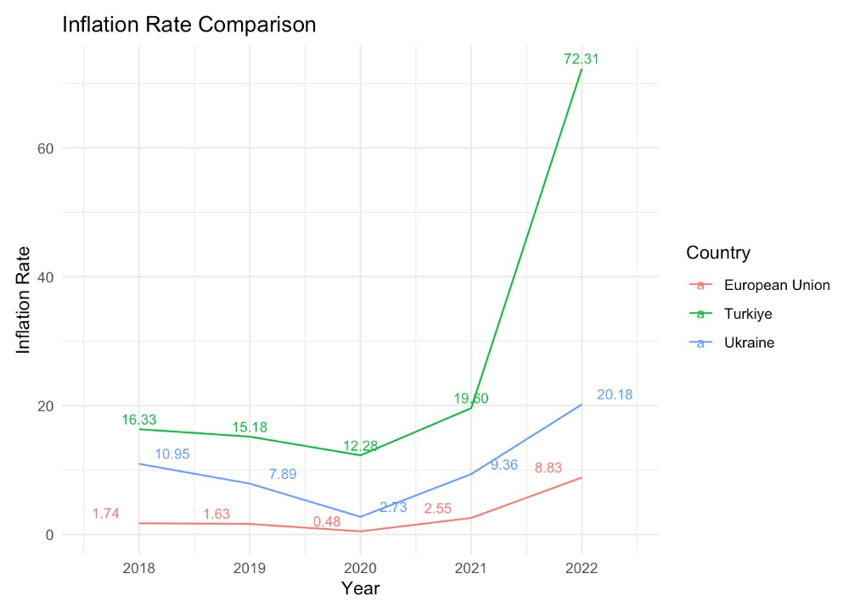
Inflation Rate Comparison

Slide 9
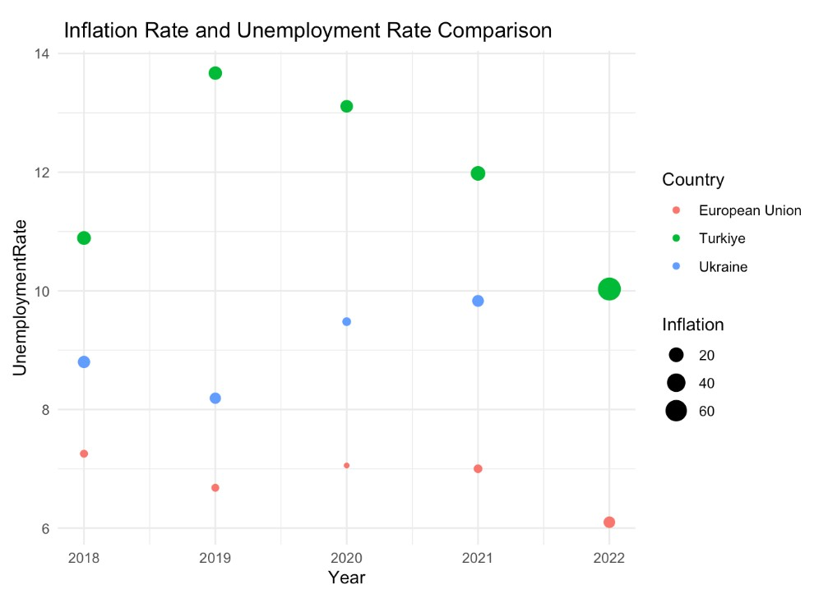
Inflation Rate and Unemployment Rate Comparison

Slide 10
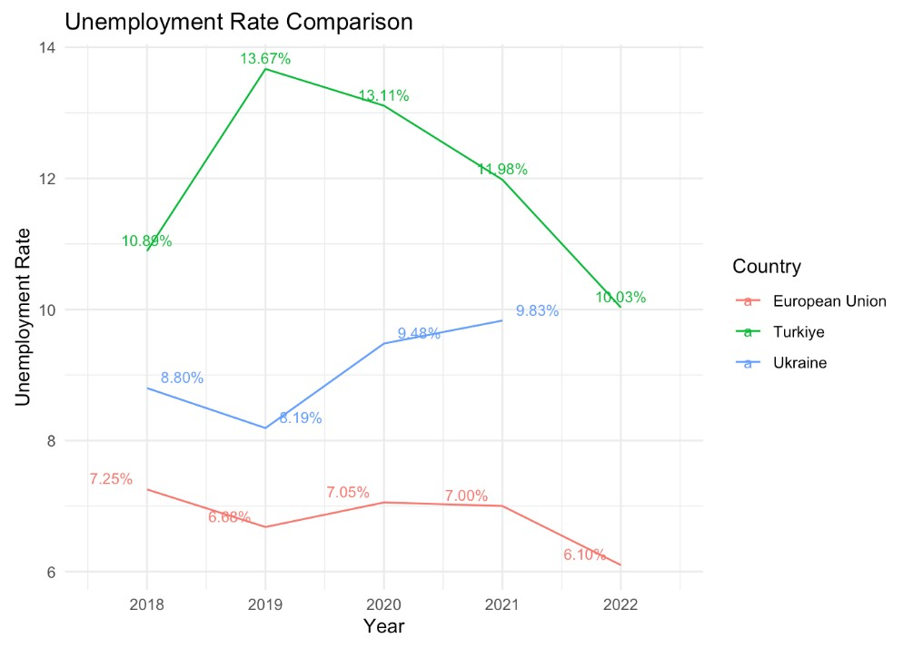
Unemployment Rate Comparison

Slide 11
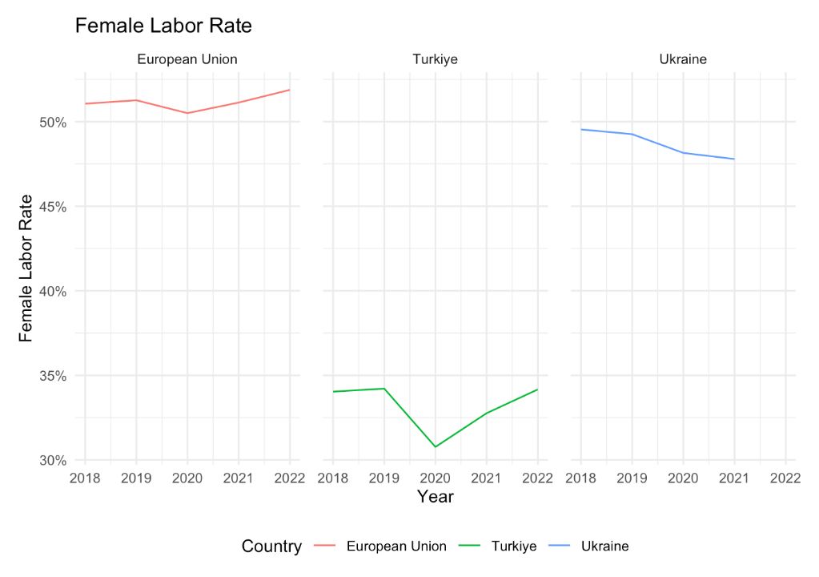
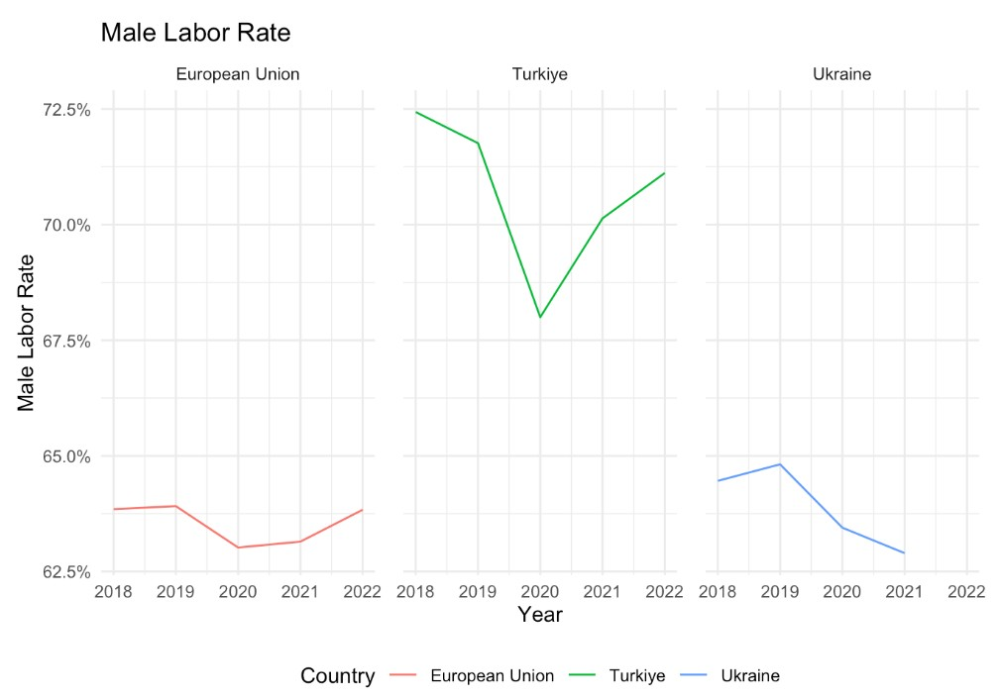
Female/Male Labor Rates

Slide 12

Conclusion
When comparing Ukraine and Turkey as candidates for EU membership, Turkey stands out with a larger economic scale, a larger population, and a younger demographic, potentially offering a larger future workforce and consumer market.
Turkiye has a younger demographic compared to both Ukraine and the EU, potentially larger future workforce and consumer market.
Both countries face similar challenges in labor dynamics such as unemployment and labor force participation rates.
While both Turkiye and Ukraine possess considerable economic and demographic capacities to attain EU standards, both need to make further advancements in areas such as political stability and economic harmonization.
Overall, Turkey may be slightly better positioned for EU candidacy, given its economic state and younger population.

Slide 13
Resources
https://data.tuik.gov.tr/
https://www.mahfiegilmez.com/2022/09/issizlik-oran-gercekten-dusuyor-mu.html
References
World Development Indicators (World Bank)
https://dergipark.org.tr/en/download/article-file/2058207
https://dergipark.org.tr/en/download/article-file/2692768

Slide 14
Thank You!
Progress Journal
Final Report
Shiny App

